Slide 1
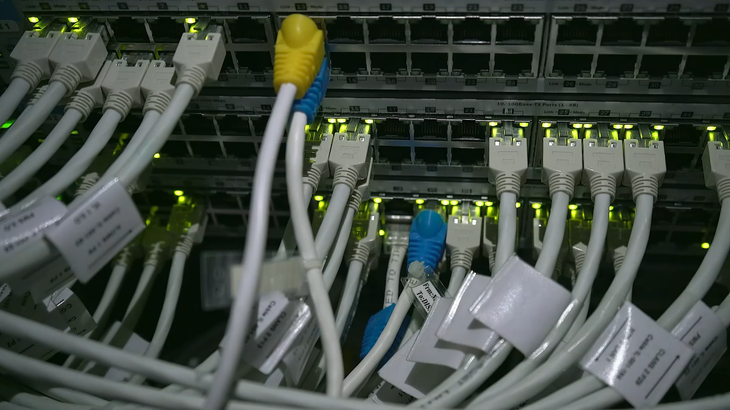
CL3001 Computer Networks
Lab 1 - Intro to Networking and Cisco Packet Tracer
Instructor: Zoya Mahboob

Slide 2
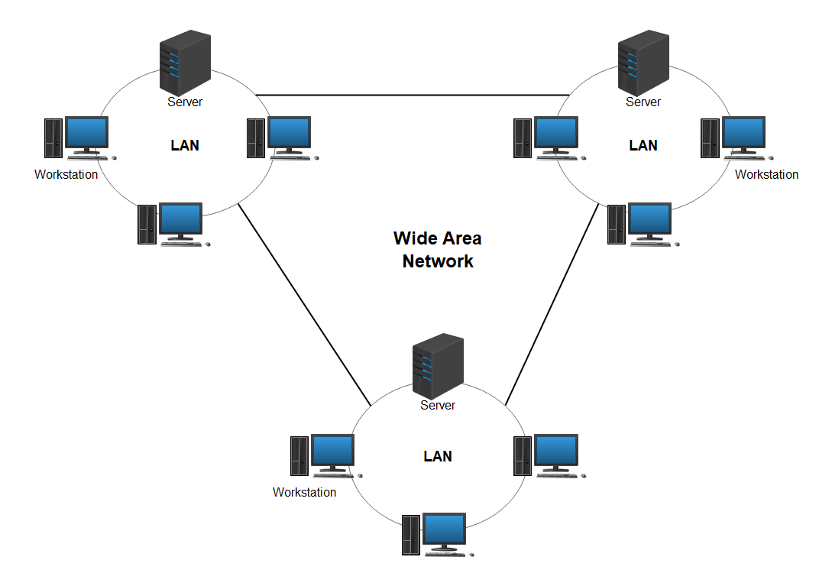
What is a network?
Computer network - collection of interconnected devices that communicate with each other to share resources and data.
LAN (Local Area Network) – buildings.
WAN (Wide Area Network) – cities, countries, continents.
Network simulation tools – CISCO.
Notes:
Let’s start with a network. By definition it means a collection of interconnected
- More simply, it’s just a bunch of devices connected to each other that share information. The collection of these devices and their cables is known as a “network”
- Networks can be of many sizes, ones that are confined to buildings for example would be called LAN
- If these networks span cities, countries or even continents that’s when we would shift into a WAN
Now as you can imagine, creating networks is expensive because of the equipment involved.
So to save ourselves money and time, we would want to simulate these connections. For that we would use network simulation tools like - CISCO

Slide 3
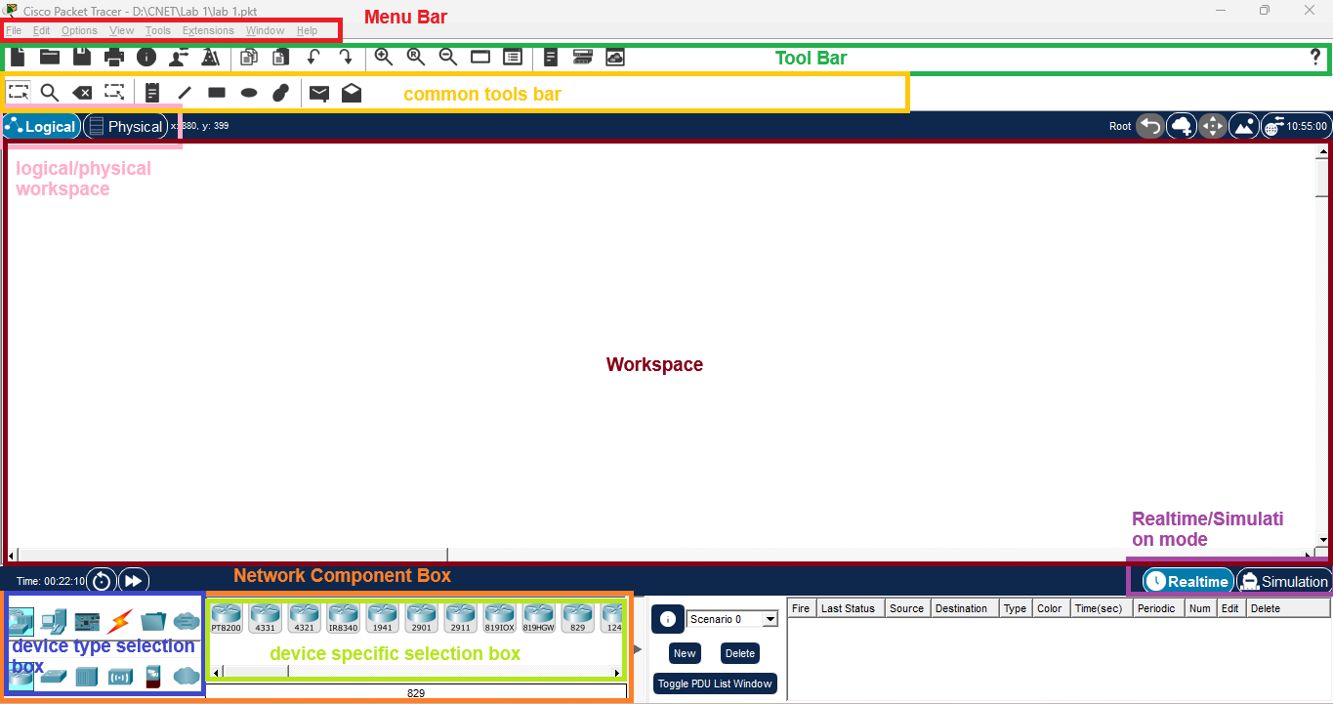
0

Slide 4
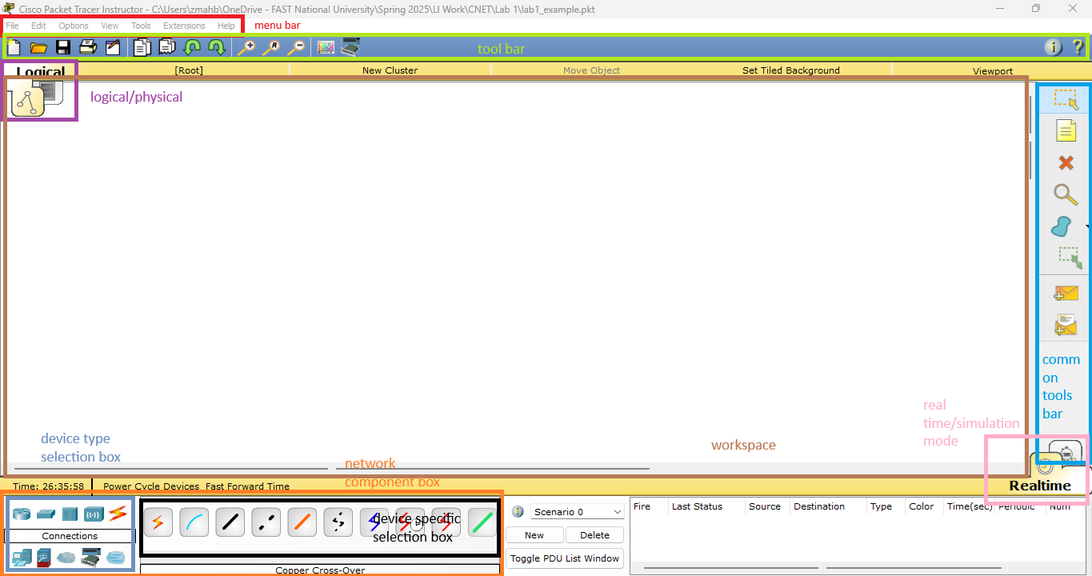

Slide 5
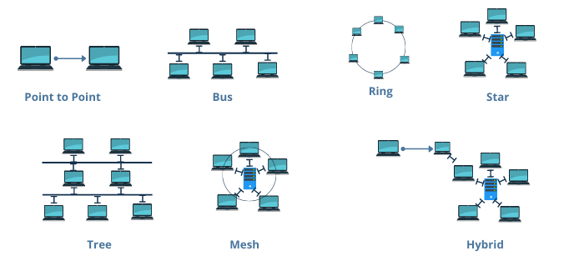
What is a topology?
Topology: Arrangement of devices on a network.
Have different names based on their shapes.
Notes:
These days it’s mostly hybrid. Now we are going to look at a simple example of a topology where we connect 2 PCs and a switch.

